Slide 1
DSCI-631, Applied Machine Learning
Title : Diamond Price Prediction
Winter 2020-21
Team Members: Himanshu Jat, Richard Hong, Manoj Venkatachalaiah

Slide 2
Overview
We have divided our overall problem into:
A Regression Problem : Where we have predicted the retail price of diamonds using several features.
A DBSCAN and regression Problem : Where we have predicted the retail price of diamonds belonging to a certain class.
Data Sources : Kaggle
Link : https://www.kaggle.com/shivam2503/diamonds

Slide 3
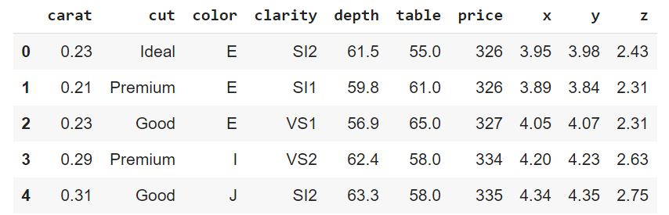
Data Description
(Raw data)
Attributes and description:
price(target attribute): price in US dollars (\$326--\$18,823)
carat: weight of the diamond (0.2--5.01)
cut: quality of the cut (Fair, Good, Very Good, Premium, Ideal)
color: diamond colour, from D (best) to J (worst)
clarity: a measurement of how clear the diamond is (I1 (worst), SI2, SI1, VS2, VS1, VVS2, VVS1, IF (best))
x: length in mm (0--10.74)
y: width in mm (0--58.9)
z: depth in mm (0--31.8)
depth: total depth percentage = z / mean(x, y) = 2 * z / (x + y) (43--79)
table: width of top of diamond relative to widest point (43--95)
Sample data:

Slide 4
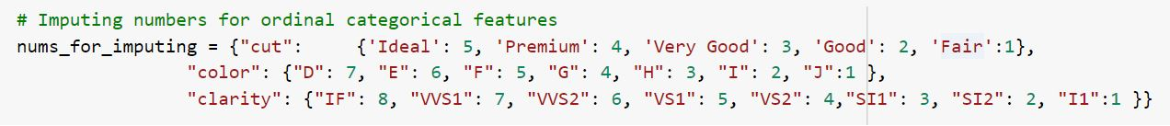
Preprocessing
Encoding the categorical features:
We used the following encoding scheme for the categorical variables color, cut and clarity
The above encoding scheme was designed based on the logic that a better cut, color and clarity should have a higher score than other values

Slide 5
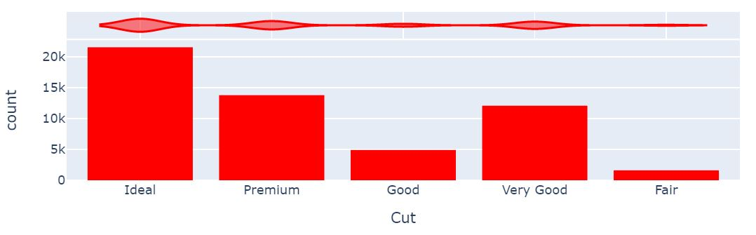
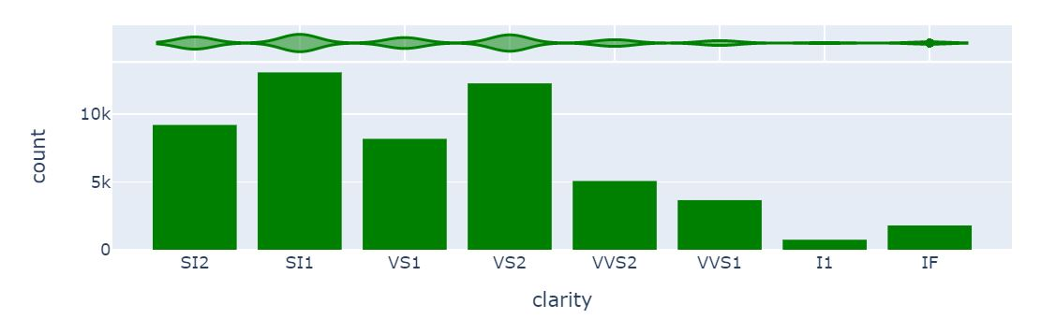
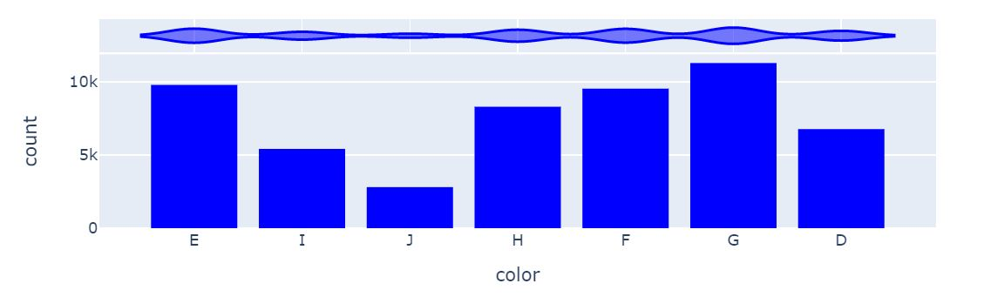
Exploratory Data Analysis
Categorical features: Cut, Clarity and Color

Slide 6
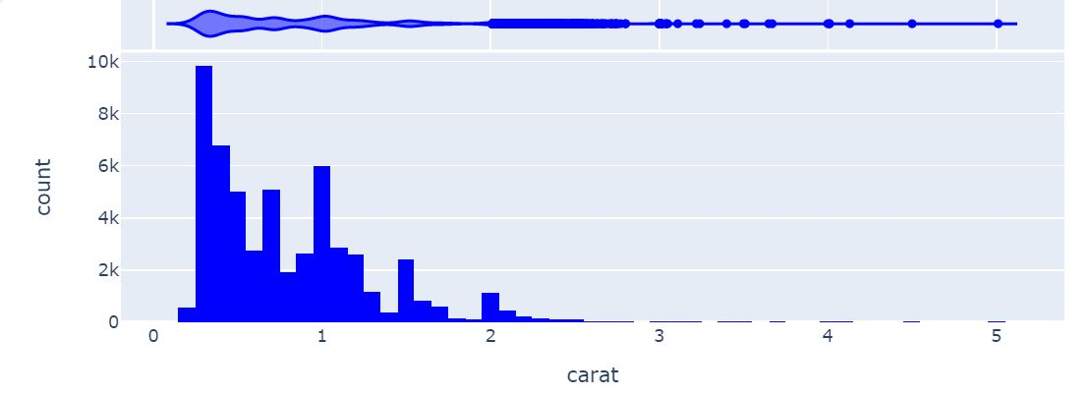
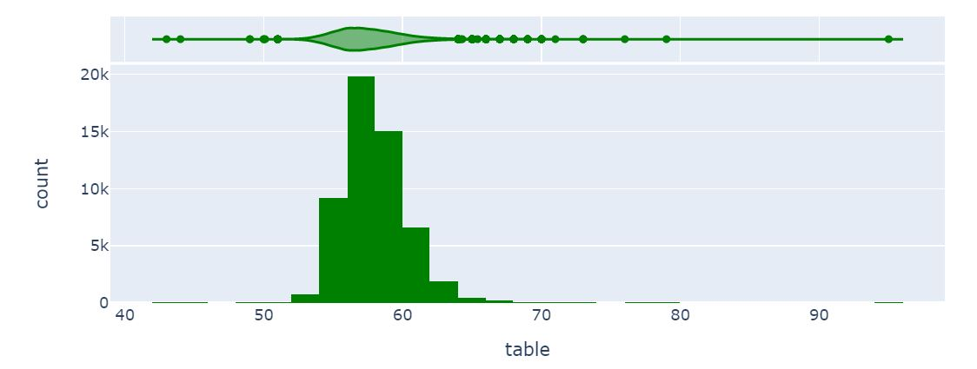
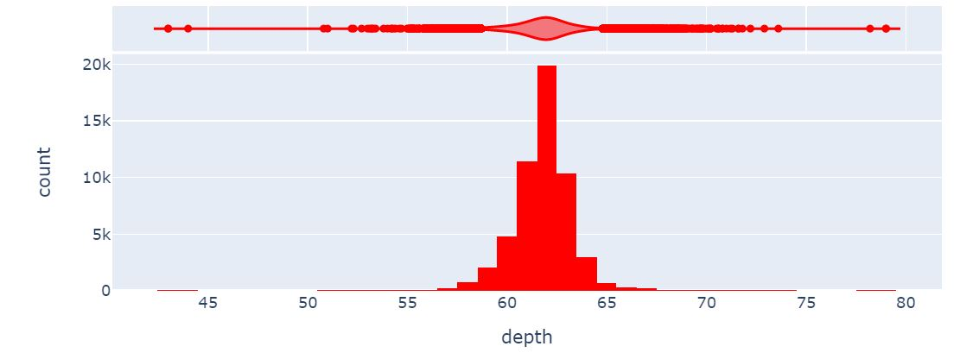
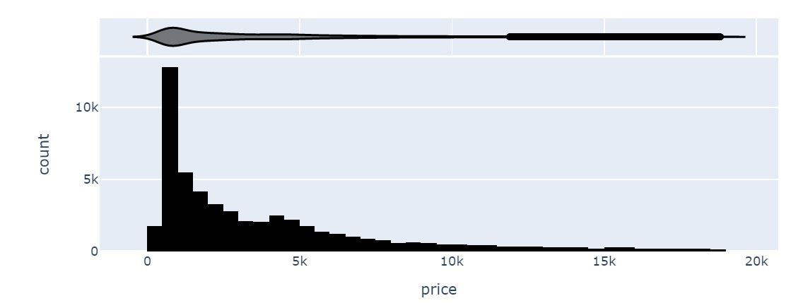
Exploratory Data Analysis
Numerical features: Carat, Depth, Table, Price (target attribute)

Slide 7
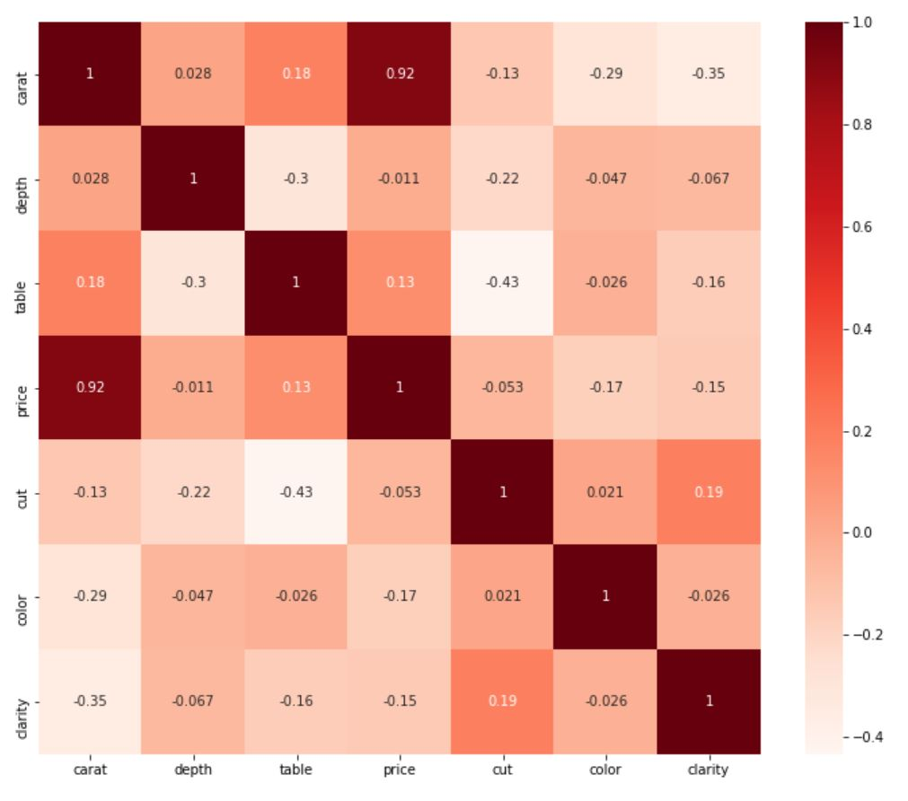
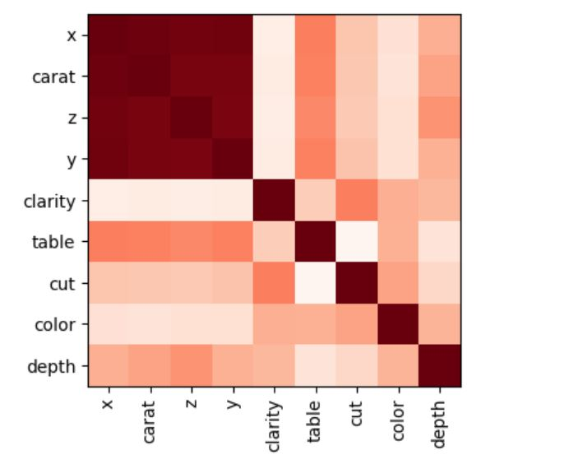
Exploratory Data Analysis
Correlation analysis
Unsupervised feature selection
Applying correlation analysis without the target value:
2) Applying correlation analysis wit the target value:
Since the attributes carat, x, y and z have a high correlativity, we decided the drop the columns x, y and z

Slide 8
Predictive modeling: Regression
Train/ test split = 80/20
Scaling method = Standard scalar
Datasets: a) Entire dataset
b) 0.25% outlier removed dataset
Procedure = for each dataset:
a) Get r2 scores by implementing 10 fold cross validation for Linear Regression,
Decision Tree Regressor, Random Forest Regressor, K Neighbors Regressor and XGB Regressor algorithms
b) Perform hyperparameter tuning using GridSearchCv on the algorithm that gives the best r2 score in step a) and get results using the test dataset

Slide 9
Predictive modeling: Regression results
Entire dataset:
R2 scores using cross-validation:
Linear Regression : 0.9040
Decision Tree Regressor : 0.9661
Random Forest Regressor : 0.9806
K Neighbors Regressor : 0.9583
XGB Regressor : 0.9759
Since the Random forest regressor gave us the best performance, we implemented hyperparameter tuning on it and evaluated it against the test data
,
Hyper-parameter tuning using GridSearchCv
param_grid = {
'bootstrap': [True],
'max_depth': [80, 90, 100, 110],
'max_features': [2, 3],
'min_samples_leaf': [3, 4, 5],
'min_samples_split': [8, 10, 12],
'n_estimators': [100, 200, 300]
}
R2 score : 0.9818

Slide 10
Predictive modeling: Regression results
0.25% outlier removed dataset:
R2 scores using cross-validation:
Linear Regression : 0.9071
Decision Tree Regressor : 0.9702
Random Forest Regressor : 0.9825
K Neighbors Regressor : 0.9630
XGB Regressor : 0.9790
Since the Random forest regressor gave us the best performance, we implemented hyperparameter tuning on it and evaluated it against the test set
,
Hyper-parameter tuning using GridSearchCv
param_grid = {
'bootstrap': [True],
'max_depth': [80, 90, 100, 110],
'max_features': [2, 3],
'min_samples_leaf': [3, 4, 5],
'min_samples_split': [8, 10, 12],
'n_estimators': [100, 200, 300]
}
R2 score : 0.9829

Slide 11
Predictive modeling: Regression results
Performance comparison:
Entire Dataset r2 scores :
Linear Regression : 0.9040
Decision Tree Regressor : 0.9661
Random Forest Regressor : 0.9806
K Neighbors Regressor : 0.9583
XGB Regressor : 0.9759
After hyperparameter tuning :
R2 score : 0.9818
10% data removed!!
0.25% outlier of standard deviation removed dataset r2 scores:
Linear Regression : 0.9071
Decision Tree Regressor : 0.9702
Random Forest Regressor : 0.9825
K Neighbors Regressor : 0.9630
XGB Regressor : 0.9790
After hyperparameter tuning :
R2 score : 0.9829

Slide 12
Predictive modeling: DBSCAN and Regression
Train/ test split = 80/20
Scaling method = Minmax scalar
Datasets: a) 4 cluster data
b) 2 cluster data
Procedure :
1) Create 4 clusters with DBSCAN algorithm using the features 'carat', 'depth', 'table',
'cut', 'color', 'clarity'. Create labels for each instance based on the cluster it belongs to.
Use Linear Regression, Decision Tree Regressor, Random Forest Regressor,
K-Neighbors Regressor, and XGB Regressor algorithms to predict each class
individually (One Vs All classification). Perform hyper-parameter tuning on the best
performing algorithm
2) Repeat step 1 for 2 clusters. Compare results.

Slide 13
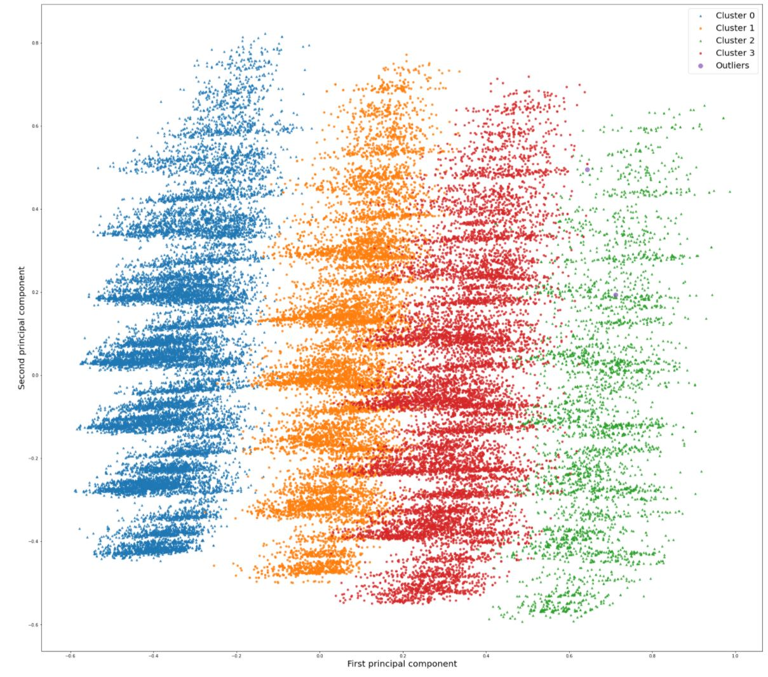
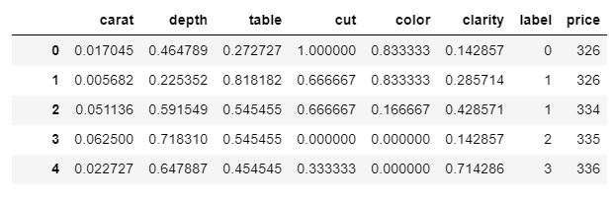
Predictive modeling: DBSCAN and Regression
DBSCAN(eps=0.3333333, min_samples=5)
Creating the clusters : 4 cluster
The shape of Cluster 0(Blue)
(20711, 8)
The shape of Cluster 1(Orange)
(12633, 8)
The shape of Cluster 2(Green)
(3941, 8)
The shape of Cluster 3(Red)
(11383, 8)

Slide 14
Predictive modeling: DBSCAN and Regression
4 cluster data:
R2 scores using cross-validation for different clusters:
Cluster 0:
Linear Regression : 0.9094
Decision Tree Regressor : 0.9707
Random Forest Regressor : 0.9825
K Neighbors Regressor : 0.9642
XGB Regressor : 0.9804
Cluster 1:
Linear Regression : 0.9075
Decision Tree Regressor : 0.9631
Random Forest Regressor : 0.9779
K Neighbors Regressor : 0.9494
XGB Regressor : 0.9768
Cluster 2:
Linear Regression : 0.9045
Decision Tree Regressor : 0.9578
Random Forest Regressor : 0.9756
K Neighbors Regressor : 0.9364
XGB Regressor : 0.9743
Cluster 3:
Linear Regression : 0.9155
Decision Tree Regressor : 0.9708
Random Forest Regressor : 0.9830
K Neighbors Regressor : 0.9607
XGB Regressor : 0.9825
Hyper-parameter tuning using GridSearchCv:
param_grid = {
'bootstrap': [True],
'max_depth': [80, 90, 100, 110],
'max_features': [2, 3],
'min_samples_leaf': [3, 4, 5],
'min_samples_split': [8, 10, 12],
'n_estimators': [100, 200, 300]
}
R2 score of testing data:
Cluster 0: 0.9826
Cluster 1: 0.9786
Cluster 2: 0.9668 (3941 instances, the lowest r2 score)
Cluster 3: 0.9838 (11383 instances)

Slide 15
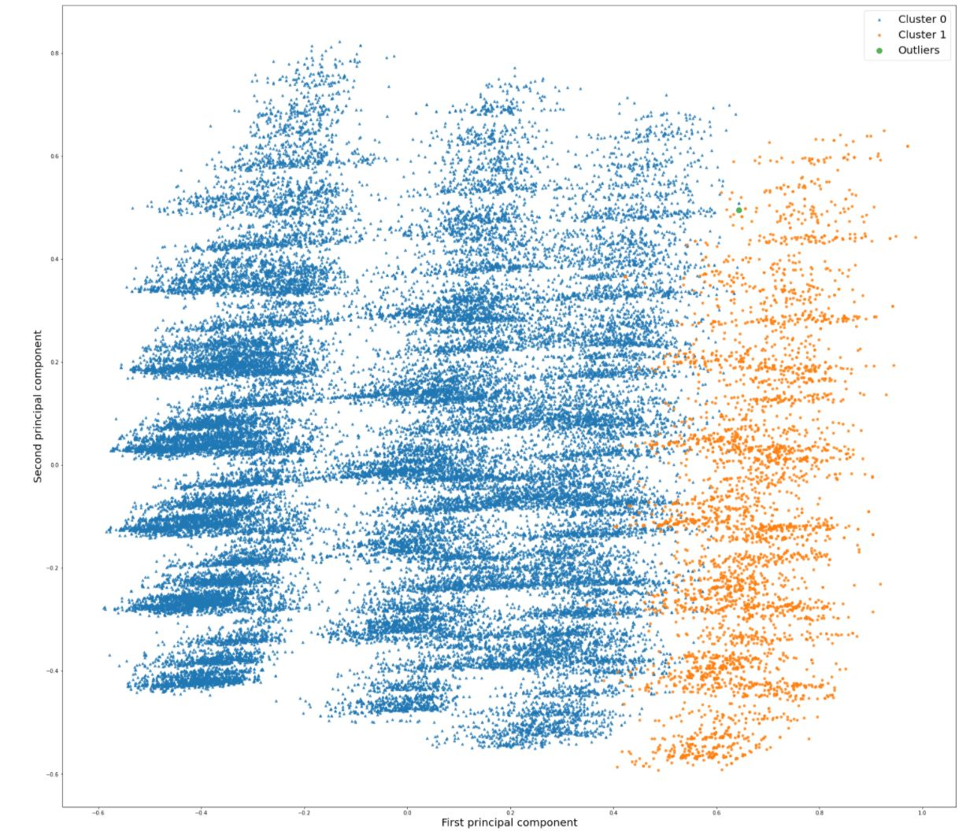
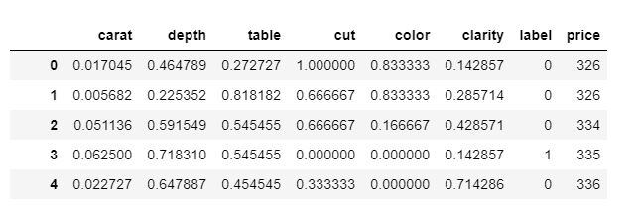
Predictive modeling: DBSCAN and Regression
dbscan = DBSCAN(eps=1/3, min_samples=2)
Creating the clusters : 2 cluster
The shape of Cluster 0
(44727, 8)
The shape of Cluster 1
(3942, 8)

Slide 16
Predictive modeling: DBSCAN and Regression
2 cluster data:
R2 scores using cross-validation for different clusters:
Cluster 0:
Linear Regression : 0.9088
Decision Tree Regressor : 0.9699
Random Forest Regressor : 0.9824
K Neighbors Regressor : 0.9626
XGB Regressor : 0.9792
Cluster 1:
Linear Regression : 0.9044
Decision Tree Regressor : 0.9591
Random Forest Regressor : 0.9743
K Neighbors Regressor : 0.9356
XGB Regressor : 0.9740
Hyper-parameter tuning using GridSearchCv:
param_grid = {
'bootstrap': [True],
'max_depth': [80, 90, 100, 110],
'max_features': [2, 3],
'min_samples_leaf': [3, 4, 5],
'min_samples_split': [8, 10, 12],
'n_estimators': [100, 200, 300]
}
R2 score of testing data :
Cluster 0: 0.9838 (44727 instances)
Cluster 1: 0.9703

Slide 17
Conclusion
Summary
Regression
Without hyperparameter tuning: 0.9825
With hyperparameter tuning: 0.9828
DBSCAN and Regression
Without hyperparameter tuning:
Cluster 0: 0.9825
Cluster 1: 0.9743
With hyperparameter tuning:
Cluster 0: 0.9838
Cluster 1: 0.9703
Random forest algorithms gave us the best results in both stages of the project, although the other algorithms weren’t behind my a lot.

